Slide 1
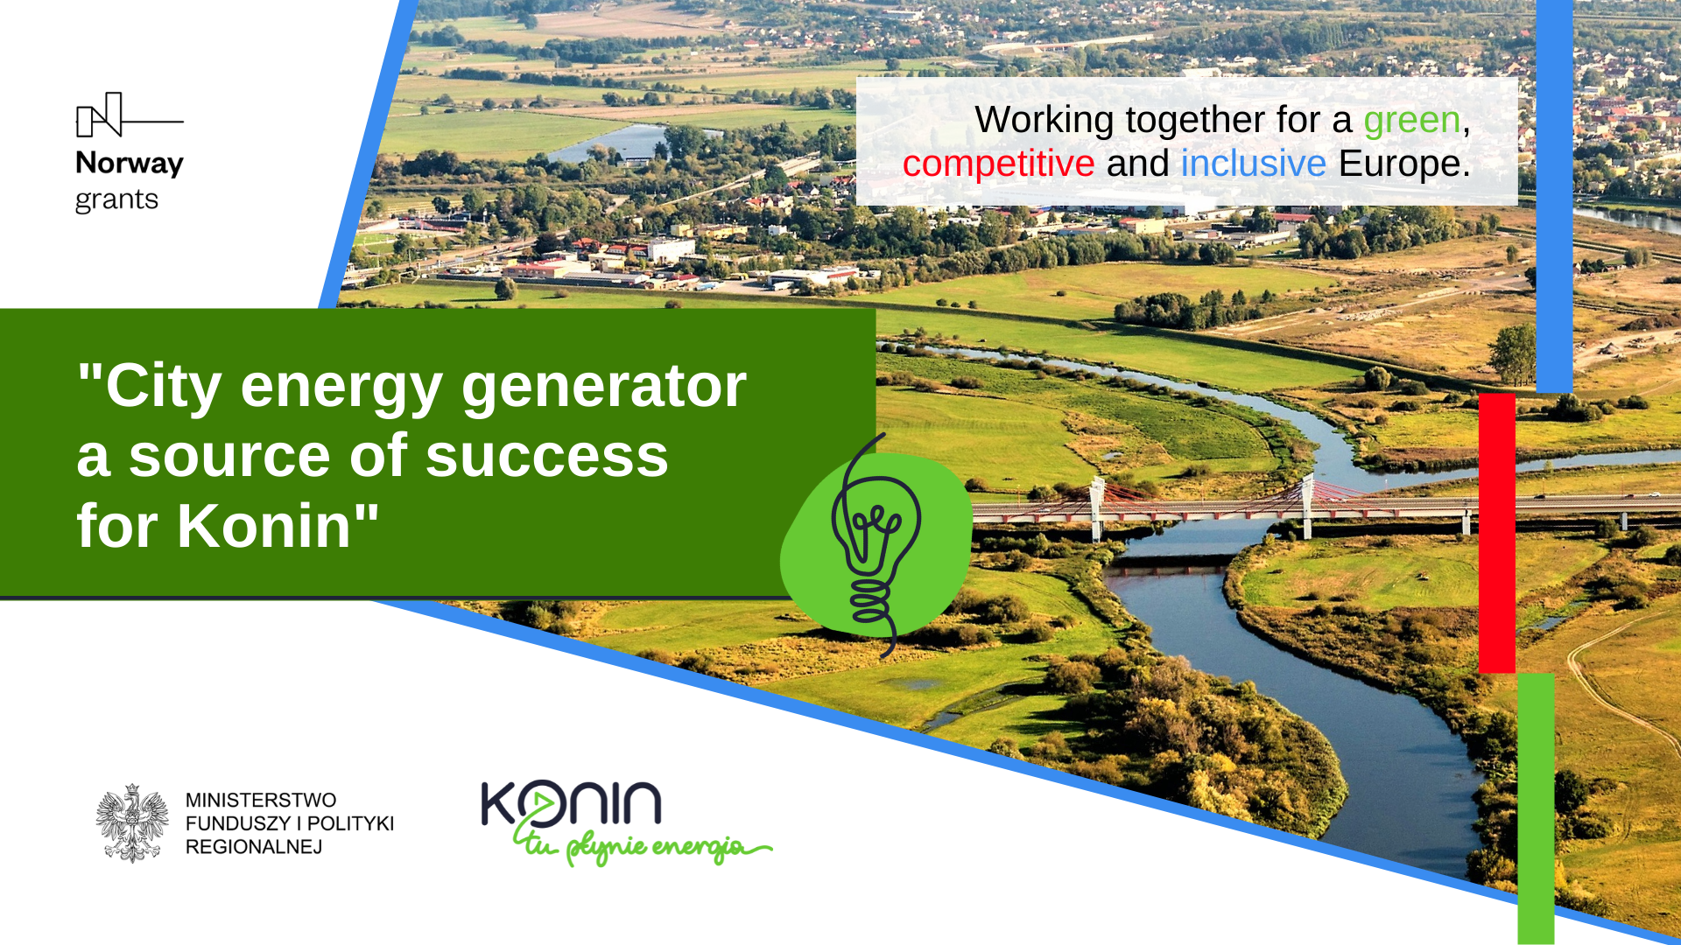

Slide 2
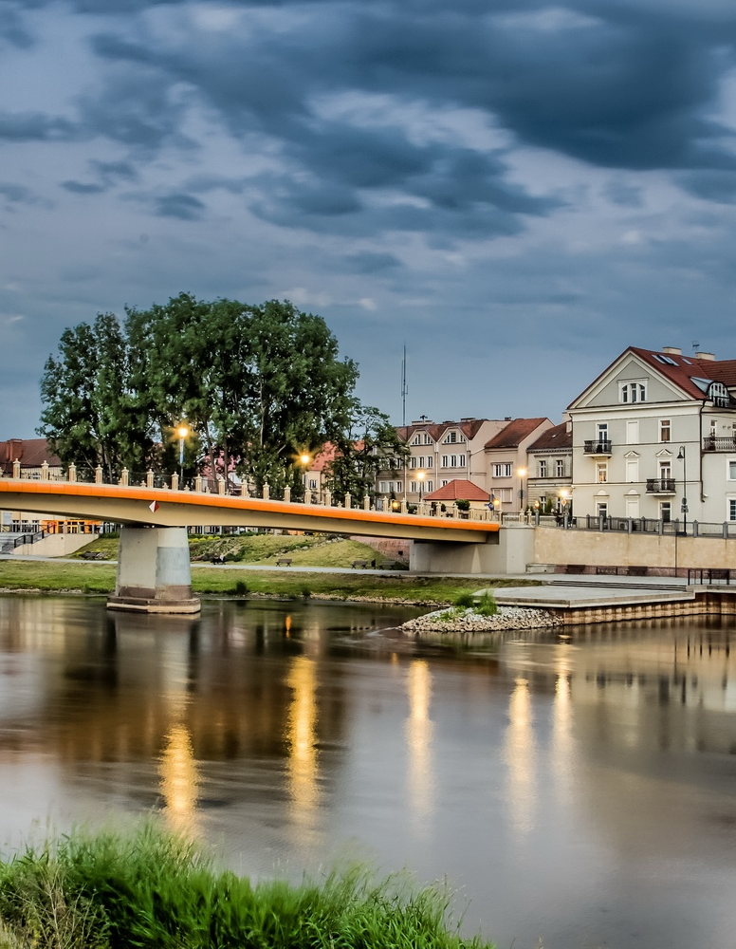


The aim of the project „The City energy generator a source of success for Konin" is to introduce the City of Konin to the New Development Path, which is the Green City of Energy

Slide 3
Through the implementation of the project, Konin will become a prosperous and entrepreneurial city, and the inhabitants will benefit from its 9 effects
Institutional development
30.04.2024
END OF THE PROJECT
Footbridge and path
The place of activity
Entrepreneurship development
Senior policy
New IT system
Application
Qualified staff
Ecological buildings
01.10.2021 BEGINNING OF THE PROJECT

Slide 4
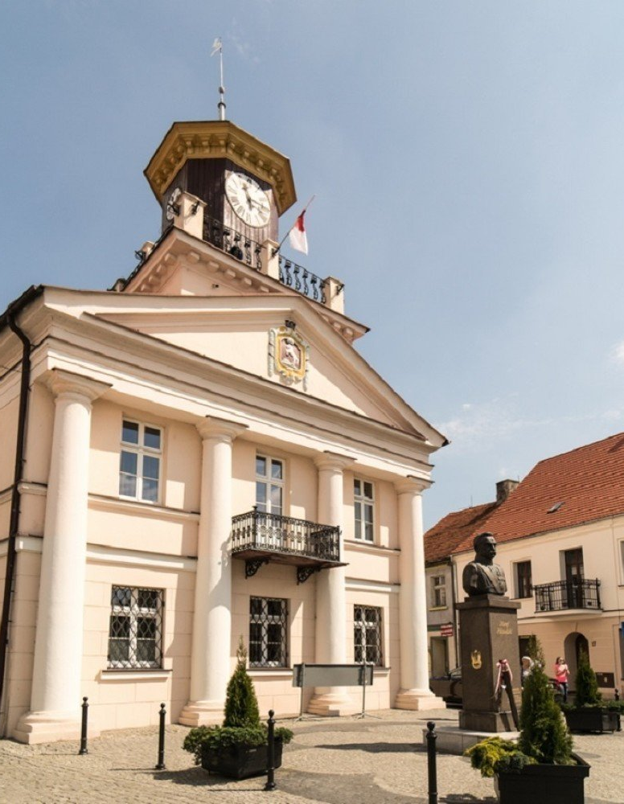
1. Institutional development
The Municipal Office in Konin will be a prepared institution for the implementation and management of many investments indicated in the New Development Path

Slide 5

2. Qualified staff
New competences acquired by officials will contribute to better implementation of projects, and the residents are and will be serviced by qualified and experienced employees.

Slide 6

3. New IT system
A new IT system will be created in the Municipal Office to improve the quality of services provided, and residents will be able to use new e-services (e.g., taxes, rubbish, applying for open clerical positions, etc.).

Slide 7
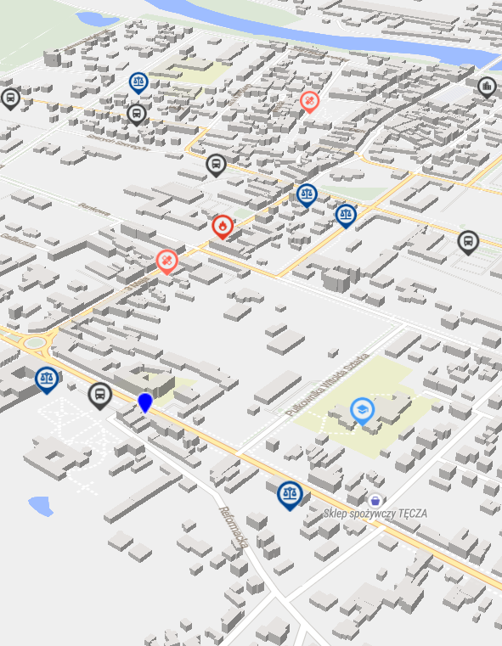
4. Application
Residents will be able to use the Application - an available urban space that will show places of public space (passages, stops, buildings) that are available to people with special needs.

Slide 8
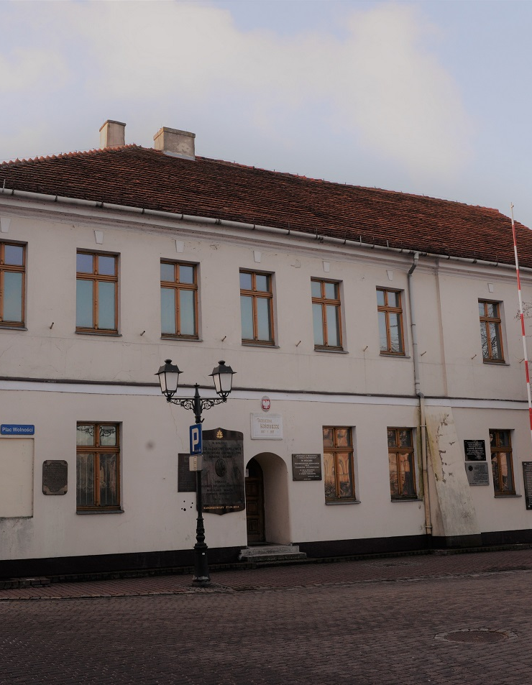
5. A place of cultural activity
A Cultural Activity Incubator will be established, where residents will be able to spend their free time, developing their interests and taking advantage of the educational and cultural offer.

Slide 9

6. Entrepreneurship development
Students and teachers will gain practical knowledge on entrepreneurship through participation in the campaign "How to be entrepreneurial".

Slide 10

7. Senior policy
A document will be created that will present the current situation of seniors in the City of Konin (their needs and barriers) and will define the actions that the City of Konin should take to support seniors.

Slide 11
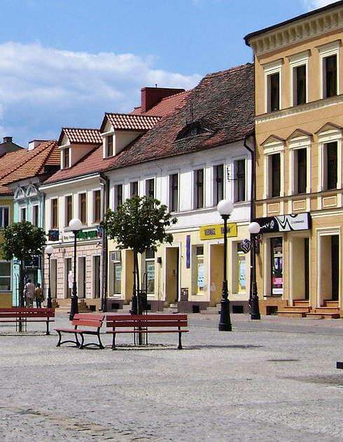
8. Ecological buildings
Residents will breathe fresh air as we are starting the process of comprehensive energy modernization of municipal buildings.

Slide 12
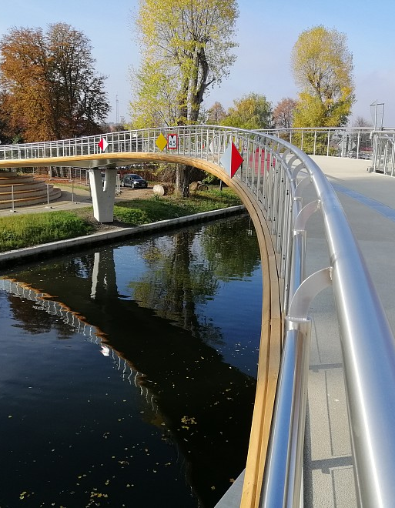
9. Footbridge and bicycle path
The residents will actively use the footbridge over the Ulga canal along with the pedestrian and bicycle path connecting the new part of Konin with the Old Town.

Slide 13
Cooperation with the Ministry of Funds and Regional Policy
Professional advice of the Association of Polish Cities
Openness and readiness of city management to introduce changes
Knowledge, experience and diligence of the Project Implementation Team

Slide 14
Thank you for attention
Katarzyna Rejniak - Project manager
Wydział Rozwoju i Inwestycji
Tel. 63 240-11-51
katarzyna.rejniak@konin.um.gov.pl
The press conference on 3 December 2021 has been financed
from the Norwegian Financial Mechanism 2014-2021 and the State Budget

Slide 15


